Slide 1
The First Century Cultural Background

Slide 2
Homer
“Even thus did we bore the red hot beam into his eye, till the boiling blood bubbled all over it as we worked it round and round, so that the steam from the burning eyeball scalded his eyelids and eyebrows, and the roots of the eye sputtered in the fire. As a blacksmith plunges [baptizes] an axe or hatchet into cold water to temper it- for it is this that gives strength to the iron- and it makes a great hiss as he does so, even thus did the Cyclops' eye hiss round the beam of olive wood...” Odyssey (8th Century BC)
Connotation: | Literal: to plunge
 | Metaphorical: to temper
Meaning of Baptism: Classical Greek

Slide 3
Aeschylus
“Each wife shall rob her husband of his life, dipping [baptizing] in blood her two-edged sword.”
Prometheus, 863 (525-456 BC)
Connotation: | Literal: to plunge
 | Metaphorical: to dye
Meaning of Baptism: Classical Greek

Slide 4
Theophrastus
“[A person] goes to the hot-water tanks of the baths, draws [baptizes] a ladle full, and rinses [pours it over] himself.”
Characters (371-287 BC)
Connotation: | Literal: to dip below; immerse
Meaning of Baptism: Classical Greek

Slide 5
Dionysius
“For both, being equally hurried by passion, and considering only what they desired to effect, not what they might suffer, pushed their horses with all their force against one another; and each with unerring spears, piercing the buckler and corslet of his enemy, one hid [baptized] the point in his side, and the other in his loins…”
Roman Antiquities, 5.15.2 (60 BC – after 7 BC)
Connotation: | Literal: to plunge
 | Metaphorical: to bury, thrust
Meaning of Baptism: Koine Greek

Slide 6
LXX
Lev. 11:32 – “Every vessel…will be dipped [baptized] into water.”
Lev. 4:6 – “The priest shall dip [baptize] his finger into the blood and shall sprinkle (some) of the blood seven times before the Lord.”
Connotation: | Literal: to dip; bathe
 | Metaphorical: to dye
Meaning of Baptism: Koine Greek

Slide 7
LXX (cont.)
Num. 19:18 – “A clean person shall dip [baptize] hyssop into water and shall sprinkle around.”
Connotation: | Literal: to dip
 | (as opposed to sprinkling)
Meaning of Baptism: Koine Greek

Slide 8
Didache
Concerning baptism, baptize in this way: after speaking all these words, baptize into the name of the Father, the Son, and the Holy Spirit in living water. If you do not have living water, baptize in other water; if you are not able in cold, in warm. If you do not have either, pour water on the head three times into the name of the Father, Son, and Holy Spirit.” (40-80 AD)
Meaning of Baptism: Early Church

Slide 9
Tertullian
“We are immersed [Latin: dip, plunge] three times, making a somewhat ampler pledge than the Lord appointed in the gospels.”
On the Crown (160-225 AD)
Meaning of Baptism: Early Church

Slide 10
Eusebius on Novatian
“While being treated by the exorcists, he fell into a serious illness and was thought to be about to die. On the very bed on which he lay, he received [grace, baptism] by [water] being poured over [poured around] him, if indeed it may be said that such a one received it.”
Church History (citation from a letter, dated 251 AD)
Meaning of Baptism: Early Church

Slide 11
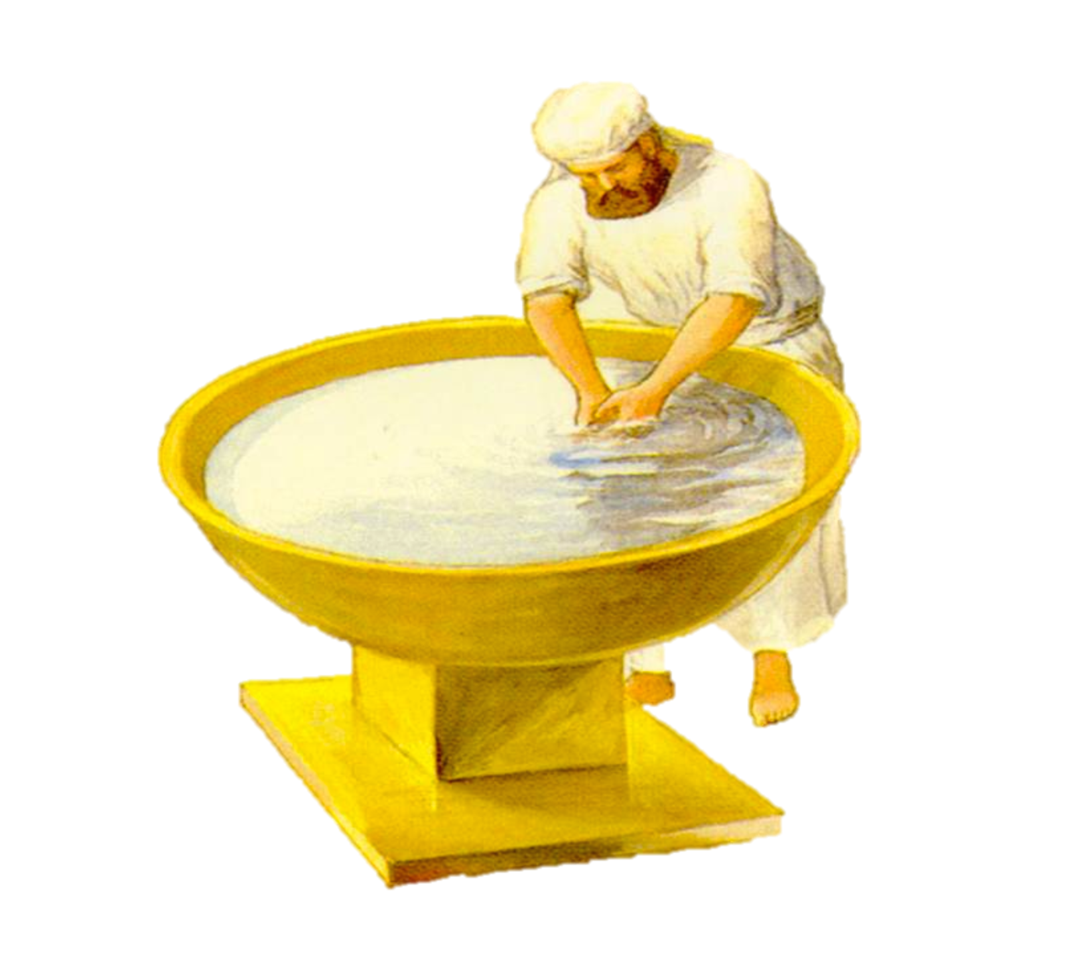
Jewish Washings

Slide 12
Josephus On Lev. 15:16
“But he that sheds his seed in his sleep, if he go down into cold water, has the same privilege with those who have lawfully accompanied their wives.” (Antiquities, 37-100 AD)
“Now if a man has a seminal emission, he shall bathe all his body in water and be unclean until evening.” (Lev. 15:16)
Jewish Washings

Slide 13
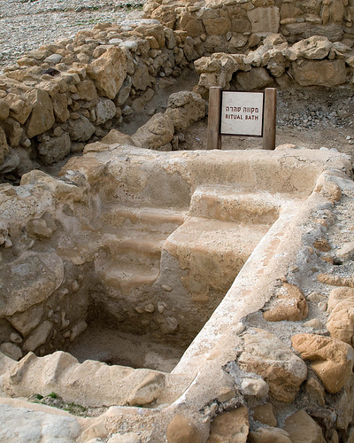
Essenes On Washings
“No man shall bathe in dirty water or in an amount too shallow to cover a man. He shall not purify himself with water contained in a vessel. And as for the water of every rock-pool too shallow to cover a man, if an unclean man touches it he renders its water as unclean as water contained in a vessel. (Damascus Document)
Jewish Washings

Slide 14
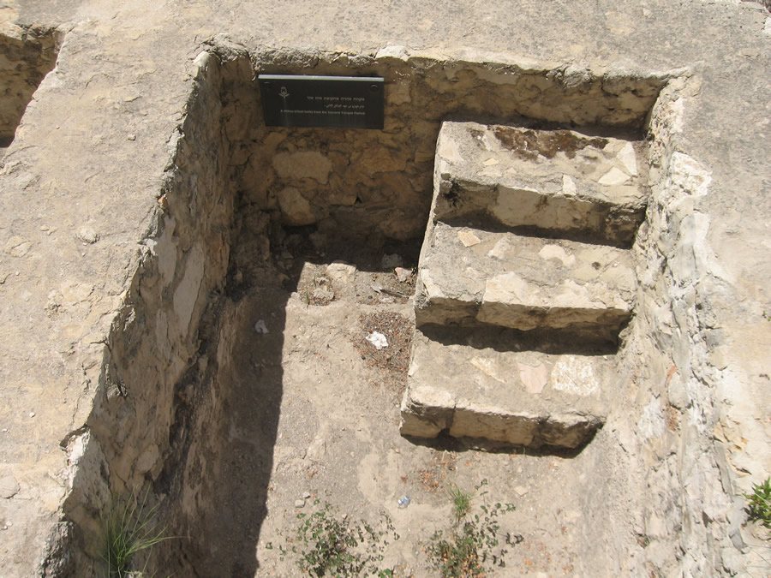
Mishnah Rules on Jewish Mikvahs
Immersion: water must touch entire body
Must contain 40 seahs of water (77-140 gal.)
Must be deep enough to permit full immersion
Must contain only clean water
Jewish Washings

Slide 15
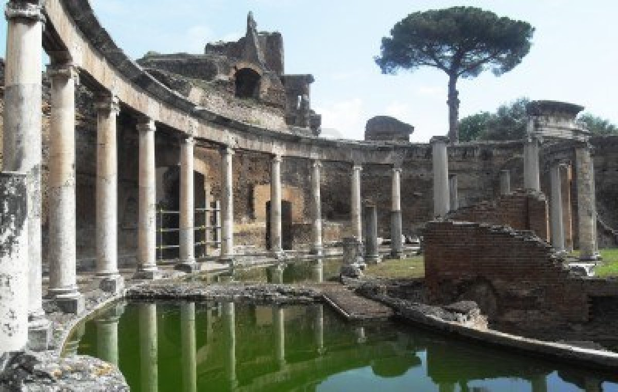
Washings: Greco-Roman Paganism

Slide 16
Oracle at Delphi
“Come, stranger, pure in mind, to the precinct of the pure god, after touching your hand in the stream of the nymphs. For a tiny drop suffices for a good man, but the whole ocean shall not cleanse a wicked man with its streams.”
Washings: Greco-Roman Paganism

Slide 17
Pythagoras
“Purity is through cleansings, washings, and lustrations [vessels for sprinkling], along with various abstinences.” (570 - 495 BC)
Washings: Greco-Roman Paganism

Slide 18
Philo on Pagan Washings
“It is foolish to forbid entrance to temples to a person who has not previously washed and cleansed his body but undertakes to pray and sacrifice with a mind still soiled and spotted.” (The Unchangeableness of God, 1st century AD)
Washings: Greco-Roman Paganism

Slide 19
Tertullian on Mystery Cults
“Also they carry their gods out for washings. Moreover they ritually purify their country and town house, their temples, and whole cities, by carrying water and sprinkling it. Certainly at the Apollinarian and Pelusian games they are immersed wholesale, and they suppose they are doing this with a view to regeneration and release from their broken oaths...” (On Baptism, c. 200 AD)
Washings: Greco-Roman Paganism

