Slide 1
.

Slide 2
God Is Great, God Is Good
Isaiah 40

Slide 3
Isaiah: Bible in miniature
Sixty-six chapters
2. Two parts: 39 + 27 chapters
3. Theme of 1-39: condemnation
4. Theme of 40-66: consolation
And behold, there was a man in Jerusalem whose name was Simeon, and this man was just and devout, waiting for the Consolation of Israel . . . – Luke 2:25

Slide 4
Isaiah 40:1-2
My people…your God (Ex.19:5-6)
Judgment for one nation…consolation for whole world
Her warfare is ended. Ro.8:37
Her iniquity is pardoned.
Double: fold over / in half; each half matches; exact correspondence between sin and payment
Word of doom
39:5-7
Word of Comfort
to the heart, 40:1

Slide 5
I. Preparation For Coming Of Lord, 3-11

Slide 6
Is.40:3, preparation
30 day journey through desert from Babylon to Judea
The highway
Remove hills
Fill valleys
Straighten curves
Clear obstacles
John:
one man road crew
LORD, God (deity)
Mk.1

Slide 7
Is.40:3, preparation
OT: “A voice cries:
‘In the wilderness prepare the way of the LORD . . .’”
Emphasis on where to prepare
NT: “The voice of one crying in the wilderness . . .”
Emphasis on where the voice cries

Slide 8
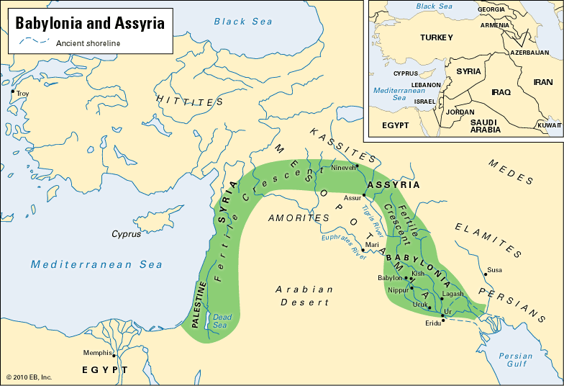
From Babylon To Judea
900 m.
500 m.

Slide 9
Is.40:4, problems
Building a road is similar to the way God prepares hearts
Babylon (Cyrus) . . . Sin (Christ):
1. Expensive (Jn.14:6)
2. Presents variety of problems, challenges (Hb.5:8)
3. Requires expert engineer (Is.9:6)

Slide 10
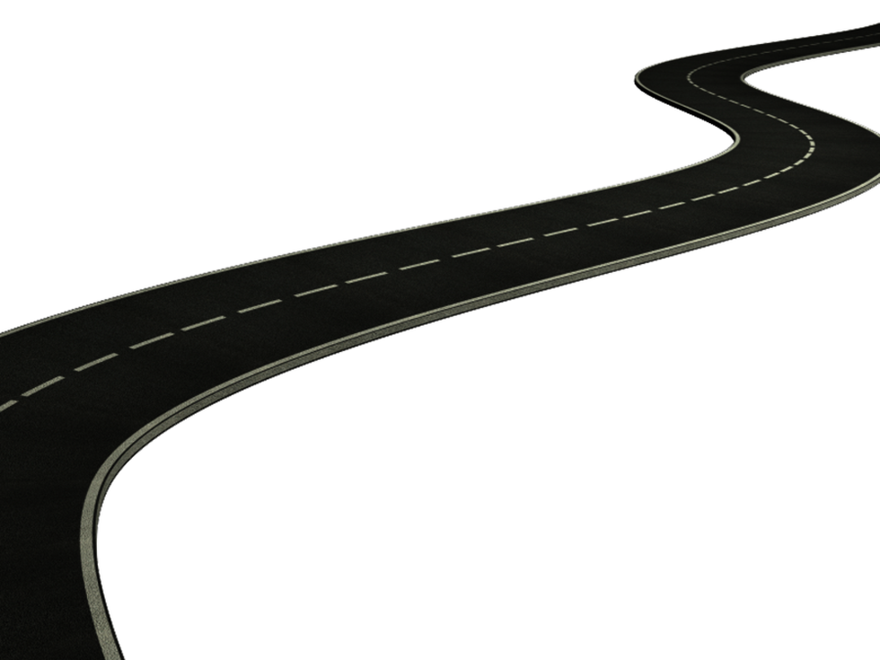
Is.40:5, people
His glory will be revealed to prepared hearts, without regard to nationality
“All flesh”
Jesus – apostles
Jn.16:12-14;
Ac.2:39;
Ac.10
John

Slide 11
Is.40:6-11, proclamation
1. Frailty of man, 6-8: All flesh is grass: Mt.6:30
Don’t worry about opponents.
2. Permanence of God, His word, 8
“I, even I, am He who comforts you.
Who are you that you should be afraid
Of a man who will die…” – Is.51:12

Slide 12
Is.40:6-11, proclamation
1. Frailty of man, 6-8 (grass)
2. Permanence of God, His word, 8
3. Certainty of His message, 9a.
1 Pt.1:22-25
4. Subject of message, 9b-11: Behold your God!
Do I help people to see God?

Slide 13
Is.40:6-11, proclamation
Behold your God!
Strong hand, to reward His own, 10
He comes as loving Shepherd, 11
Abel: slain shepherd
Jacob: working shepherd
Joseph: persecuted/exalted shepherd
Moses: called-out-from-Egypt shepherd
David: shepherd king

Slide 14
Is.40:6-11, proclamation
Behold your God!
Shows special care for lambs – youngest, weakest
Cradles them in His bosom, close to His heart

Slide 15
I. Preparation For Coming Of Lord, 1-11
II. Pertinent Lessons For People of Lord

Slide 16
1. Refuge, Isaiah 39:6-40:1
No refuge from God–only in God
Is.28:15 [16] 17. Hb.6:18
Comfort: God’s forgiveness, 2 (52:7; Ro.10:15; Ac.10)
Almighty arms that sustain the universe also gather lambs, 11

Slide 17
1. Refuge, Isaiah 39:6-40:1 2. God’s word never dies, 40:6-8
“Remember the Alamo!”
Written on perishable material
Copied for hundreds of years
Did not diminish style, accuracy
More MSS than any ten classical works combined
Diocletian; Voltaire

Slide 18
1. Refuge, Isaiah 39:6-40:1 2. God’s word never dies, 40:6-8 3. Focus on God, not self, 40:9
Our faith must come from Scripture, not ourselves or other people

Slide 19
1. Refuge, Isaiah 39:6-40:1 2. God’s word never dies, 40:6-8 3. Focus on God, not self, 40:9 4. Jesus, our Shepherd, 40:11
Not power alone, but also love to save
Good Shepherd, Jn.10:11, sacrifices life for His sheep
Great Shepherd, Hb.13:20: triumphs over every enemy for His sheep
Chief Shepherd, 1 Pt.5:4: comes for His sheep

Slide 20
I. Preparation For Coming Of Lord, 3-11
II. Pertinent Lessons
III. God Is Great, 12-31

Slide 21
Is.40:12, His power
Without help, God created . . .
Oceans: 340+ quintillion gallons
Heavens: 30+ billion light years (200 sextillion miles) – a span
Dust: earth weighs 6 sextillion metric tons
Mountains: weighs in scales

Slide 22
Is.40:13-14 (26) wisdom
His advisors? 13 → Ro.11:33-34
No counsel, instruction, teacher…
No scale model of universe
Astronomers count / classify stars
“He counts the number of the stars; He calls them all by name” – Ps.147:4

Slide 23
Is.40:15, 17, Ruler of nations
Drop in a bucket; dust on scales (Dn.5:27)
Is.37 – Assyria – no heavy-weight

Slide 24
Is.40:16, surpassing greatness
What sacrifice puts Him in our debt?
Is.40:17, Judge of nations
‘Super-powers’? Zero . . . Ps.9:17
Is.40:18-20, incomparable deity
Idols: treated wood; props…

Slide 25
Is.40:21-24, incomparable position
21: Man received His revelation at the beginning
22: above the earth – His creation
Not limited to Gn.1
Circle of earth: Isaiah knew?
“Flat earth society”

Slide 26
Is.40:22, circle of earth
“Applicable to the globular form of the earth . . .” – JFB.
Augustine: 1000 yrs before Columbus avowed round earth.
Thomas Aquinas, 13th century, observed that the spherical shape of the earth can be empirically demon-strated.

Slide 27
Is.40:21-24, incomparable position
21: Man received His revelation at the beginning
22: above the earth – His creation
22: as curtain (Gn.1:7): atmosphere
23: brings to nothing . . .
24: Gone with the wind
Nebuchadnezzar
Cyrus
Alexander
Julius…Nero…

Slide 28
Is.40:25-31, incomparable God
25-26 (18f): There is none like Him…
27: run, but cannot hide. “Seer”
28-31, all power yet cares for us (29)

Slide 29
I. Preparation For Coming Of Lord, 3-11
II. Pertinent Lessons
III. God Is Great, 12-31
IV. God Is Good, 27-31

Slide 30
1. Is.40:27 (17), do not fight God
We cannot oppose God and win

Slide 31
1. Is.40:27, do not fight God 2. Is.40:27,29, God knows
Never accuse Him of indifference
What about Babylonian exile?
God sees. 1 Pt.5:7

Slide 32
1. Is.40:27, do not fight God 2. Is.40:27, 29, God knows 3. Is.40:28-29, God is perfect
Everything He does is right
Gn.18:25

Slide 33
1. Is.40:27, do not fight God 2. Is.40:27, 29, God knows 3. Is.40:28-29, God is perfect 4. Is.40:30-31, God is all-powerful
He can make us strong (30-31)
Strength to those who wait . . .
Wait is NOT passive sitting for Lord to do something, but relying on Him instead of own strength.

Slide 34
1. Is.40:27, do not fight God 2. Is.40:27, 29, God knows 3. Is.40:28-29, God is perfect 4. Is.40:30-31, God is all-powerful
He can make us strong (30-31)
Strength to those who wait
He renews our strength as we wait
Renew – to change… put on afresh.
Here, keep putting on fresh strength.
Ep.1:19-20; 6:10; Ro.1:16

Slide 35
1. Is.40:27, do not fight God 2. Is.40:27, 29, God knows 3. Is.40:28-29, God is perfect 4. Is.40:30-31, God is all-powerful
He can make us strong (30-31)
Strength to those who wait
He renews our strength as we wait
Mount up with wings like eagles
Weak are afraid of heights
Strong Christian does not pamper himself…blame others for his sins…quit…

Slide 36
1. Is.40:27, do not fight God 2. Is.40:27, 29, God knows 3. Is.40:28-29, God is perfect 4. Is.40:31, God is all-powerful
Mount up with wings like eagles
If a descending climax (progression):
Mount up
Run
Walk

Slide 37
1. Is.40:27, do not fight God 2. Is.40:27, 29, God knows 3. Is.40:28-29, God is perfect 4. Is.40:31, God is all-powerful
Mount up with wings like eagles
If a descending climax (progression)
If simultaneous: describes our life (three views at same time):
Soar
Run
Walk

