Slide 1
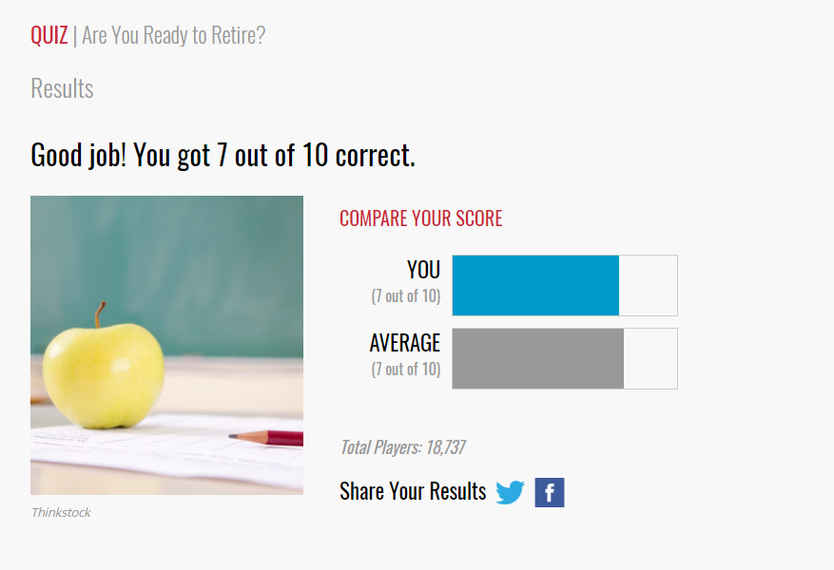

Slide 2
21st Century Christianity
Retirement Planning

Slide 3
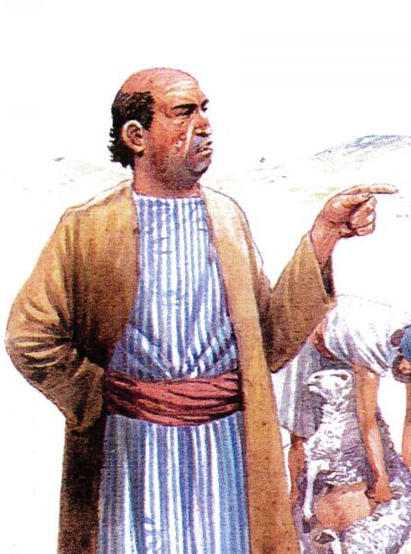
Lessons from a Fool
1st Samuel 25
From the outside perspective, Nabal had it all – wealth, servants, and a woman
Worldly success and character don’t go hand in hand
Without revelation, many people can’t even see God moving (or not moving) in their lives
Luke 12:13-21
There is a fine line between having it all and having nothing
What can we learn from a fool?

Slide 4
Worldly Security Is No Security
Part of having wealth means we may find some security in it
Psalm 49:6-10
Success can’t prevent you from facing the same end everyone faces
Nabal was feasting when he should have been fearful
Our lives can be taken from us at any moment
Even if we live, the LORD may return and we will have to give an account of the deeds done in the body

Slide 5
Generosity Is The Way To Success
$
Why do you think Nabal was unwilling to give some of what he had?
Holding on to our possessions will offer no long term benefits
Abigail saw that by giving to others she might save their lives
2nd Corinthians 9:6-9
God can cause generosity to overflow into abundance
You won’t hear that message in worldly retirement planning!

Slide 6
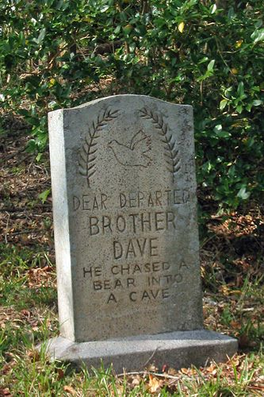
Can’t Predict the End
James 4:13-16
Nabal was the arrogant man in James 4, continuing to live as if the end would never come
The rich man felt he had “many years to come”
Over lives need to be lived like TODAY was our last day
Retirement planning isn’t planned once you retire, it is done so you will be able to
Neither of them were rich towards God

Slide 7
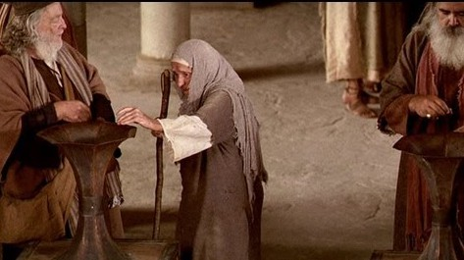
Two Extremes
Expecting nothing, lends to anyone who asks
Lend to family and friends, but still expect it back
Occasional Generosity
Covetousness, Greed, Idolatry
Godliness
Worldliness

Slide 8
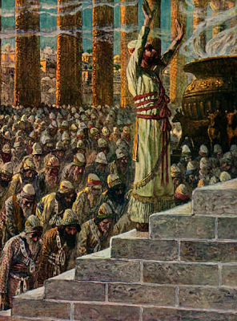
Real Retirement Planning
It’s not a gift if it doesn’t involve sacrifice
2nd Samuel 24:24
This takes humility – we see God (and others) as better than ourselves
God asked for the best, and many people refused to sacrifice the best for God, so they brought Him the worst
It wasn’t easy for the early church to give as they did, but it was a sacrifice they were willing to make

Slide 9
Real Retirement Planning
Contentment is the key to happiness
1st Timothy 6:6-8
Can we say we are content with these things?
Otherwise we fall into an opportunity for Satan to take advantage of us
We can’t store up things for this life and be rich toward God in the next

Slide 10
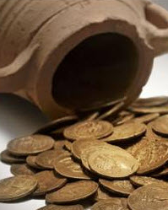
Real Retirement Planning
Laying up in Heaven involves leaving it here
Mark 10:21
If we want to lay up treasure in heaven, we do that by giving to the poor
Parting with what we possess may be necessary, and we should gladly do it!
Are we generous to the level God expects?
What level of generosity has God prepared for us?
1st Peter 1:1-3

