Slide 1
Preparing to
Teach the Lost
Luke 19:10
By David Dann

Slide 2
Preparing to Teach the Lost

Slide 3
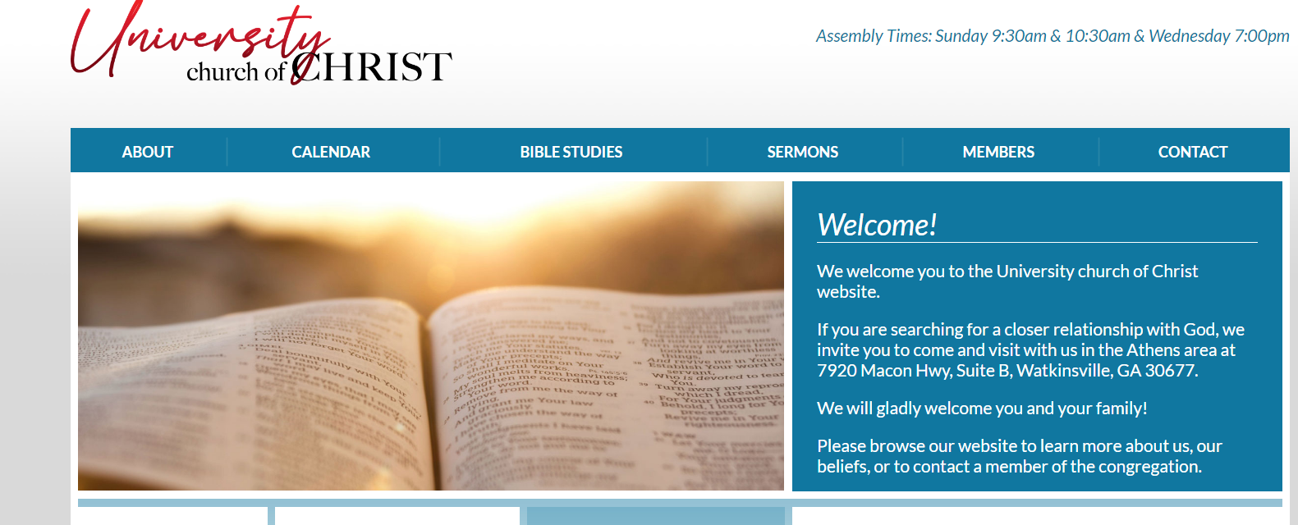
Preparing to Teach the Lost
www.uccathens.com

Slide 4
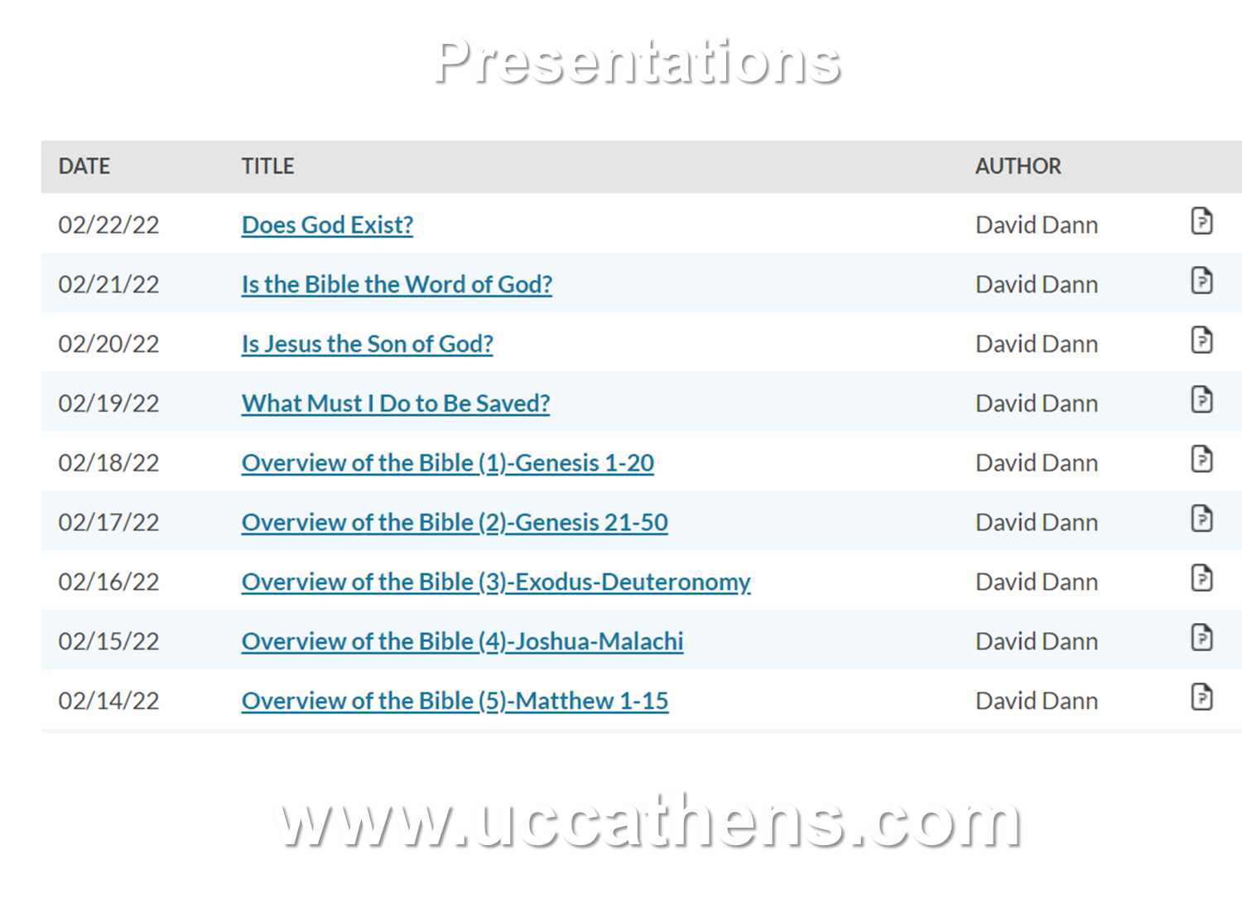
Preparing to Teach the Lost

Slide 5
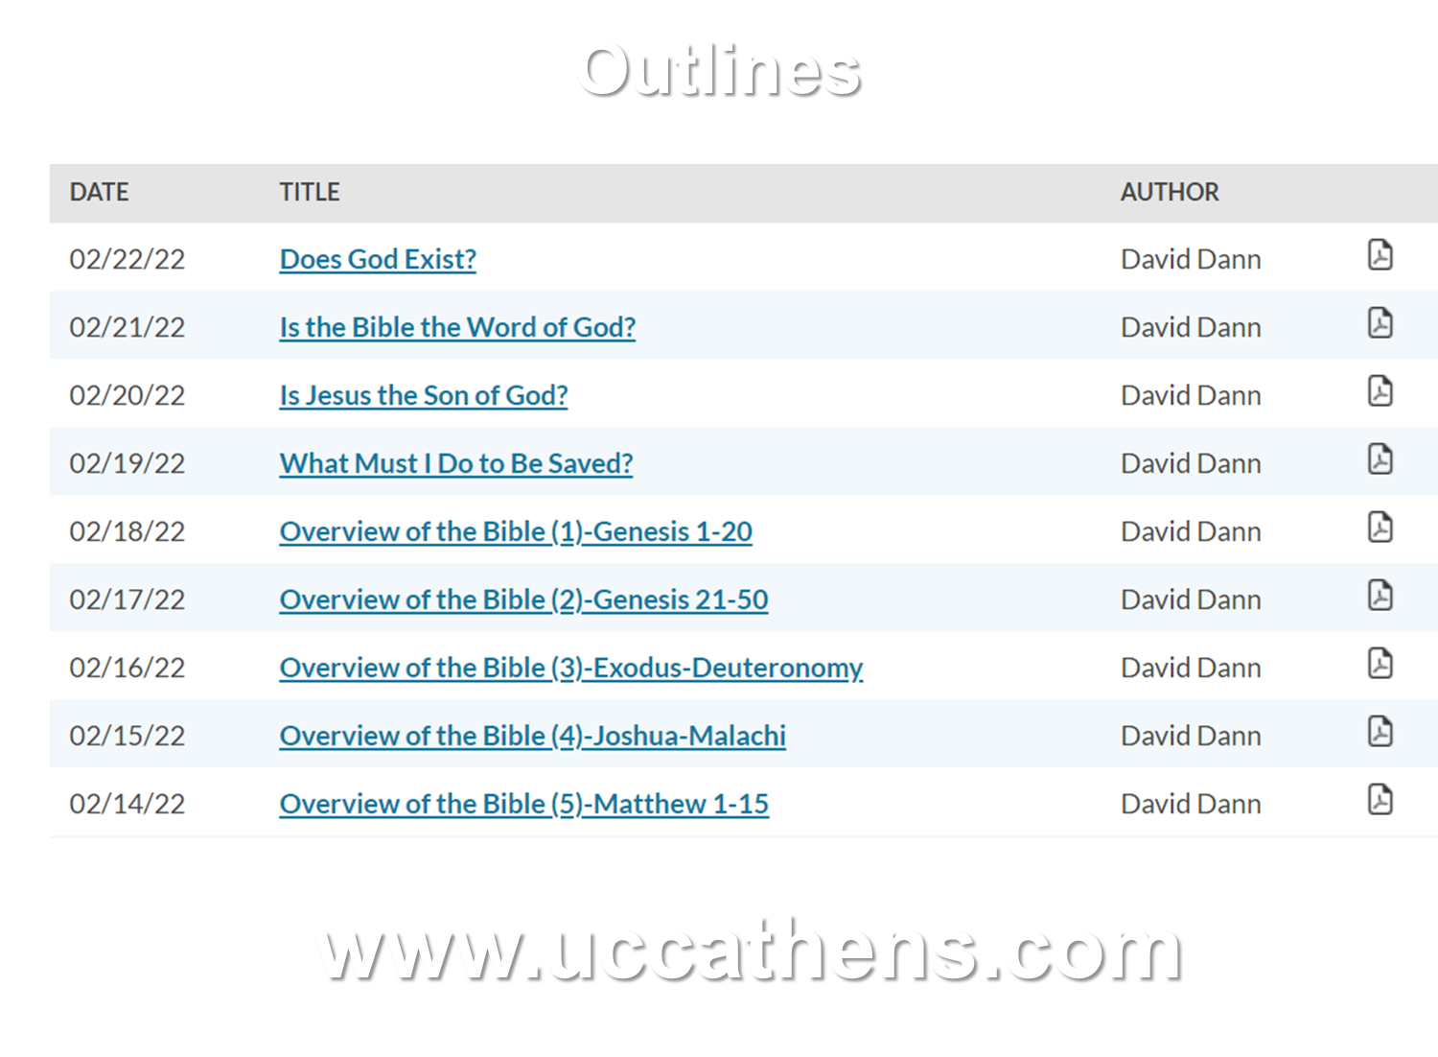
Preparing to Teach the Lost

Slide 6

Preparing to Teach the Lost

Slide 7
Preparing to Teach the Lost
Luke 19:10
10 "for the Son of Man has come to seek and to save that which was lost."

Slide 8
Preparing to Teach the Lost
Luke 6:31
31 "And just as you want men to do to you, you also do to them likewise."

Slide 9
Preparing to Teach the Lost
Proverbs 11:30
30 The fruit of the righteous is a tree of life, And he who wins souls is wise.

Slide 10
Preparing to Teach the Lost
Luke 10:2
2 Then He said to them, "The harvest truly is great, but the laborers are few; therefore pray the Lord of the harvest to send out laborers into His harvest."

Slide 11
Preparing to Teach the Lost
Romans 10:13-17
13 For "whoever calls on the name of the LORD shall be saved."
14 How then shall they call on Him in whom they have not believed? And how shall they believe in Him of whom they have not heard? And how shall they hear without a preacher?
15 And how shall they preach unless they are sent? As it is written: "How beautiful are the feet of those who preach the gospel of peace, Who bring glad tidings of good things!"
16 But they have not all obeyed the gospel. For Isaiah says, "Lord, who has believed our report?"
17 So then faith comes by hearing, and hearing by the word of God.

Slide 12
Preparing to Teach the Lost

Slide 13
Preparing to Teach the Lost
1
Understand What We Are Seeking To Accomplish

Slide 14
Preparing to Teach the Lost
1
Understand What We Are Seeking To Accomplish
  The goal: Converting lost sinners to Christ so that they will be saved.

Slide 15
Preparing to Teach the Lost
1
Understand What We Are Seeking To Accomplish
  The goal: Converting lost sinners to Christ so that they will be saved.

Slide 16
Preparing to Teach the Lost
Romans 3:23
23 …for all have sinned and fall short of the glory of God…

Slide 17
Preparing to Teach the Lost
John 14:6
6 Jesus said to him, "I am the way, the truth, and the life. No one comes to the Father except through Me."

Slide 18
Preparing to Teach the Lost
1
Understand What We Are Seeking To Accomplish
  The goal: Converting lost sinners to Christ so that they will be saved.

Slide 19
Preparing to Teach the Lost
1
Understand What We Are Seeking To Accomplish
  The goal: Converting lost sinners to Christ so that they will be saved.
  What are we NOT trying to accomplish?

Slide 20
Preparing to Teach the Lost
Acts 4:12
12 "Nor is there salvation in any other, for there is no other name under heaven given among men by which we must be saved."

Slide 21
Preparing to Teach the Lost
1
Understand What We Are Seeking To Accomplish
  The goal: Converting lost sinners to Christ so that they will be saved.
  What are we NOT trying to accomplish?

Slide 22
Preparing to Teach the Lost

Slide 23
Preparing to Teach the Lost
2
Know What To Expect

Slide 24
Preparing to Teach the Lost
2
Know What To Expect
  Some will desire to hear & obey, and others will not.

Slide 25
Preparing to Teach the Lost
Matthew 13:3-8
3 Then He spoke many things to them in parables, saying: "Behold, a sower went out to sow.
4 "And as he sowed, some seed fell by the wayside; and the birds came and devoured them.
5 "Some fell on stony places, where they did not have much earth; and they immediately sprang up because they had no depth of earth.
6 "But when the sun was up they were scorched, and because they had no root they withered away.
7 "And some fell among thorns, and the thorns sprang up and choked them.
8 "But others fell on good ground and yielded a crop: some a hundredfold, some sixty, some thirty."

Slide 26
Preparing to Teach the Lost
2
Know What To Expect
  Some will desire to hear & obey, and others will not.

Slide 27
Preparing to Teach the Lost
2
Know What To Expect
  Some will desire to hear & obey, and others will not.
  We will encounter two types of people:

Slide 28
Preparing to Teach the Lost
2
Know What To Expect
  Some will desire to hear & obey, and others will not.
  We will encounter two types of people:
    Those who are seeking.

Slide 29
Preparing to Teach the Lost
2
Know What To Expect
  Some will desire to hear & obey, and others will not.
  We will encounter two types of people:
    Those who are seeking.
    Those who enjoy arguing.

Slide 30
Preparing to Teach the Lost
Luke 10:10-11
10 "But whatever city you enter, and they do not receive you, go out into its streets and say,
11 'The very dust of your city which clings to us we wipe off against you. Nevertheless know this, that the kingdom of God has come near you.'"

Slide 31
Preparing to Teach the Lost
Acts 13:50-51
50 But the Jews stirred up the devout and prominent women and the chief men of the city, raised up persecution against Paul and Barnabas, and expelled them from their region.
51 But they shook off the dust from their feet against them, and came to Iconium.

Slide 32
Preparing to Teach the Lost
2
Know What To Expect
  Some will desire to hear & obey, and others will not.
  We will encounter two types of people:
    Those who are seeking.
    Those who enjoy arguing.

Slide 33
Preparing to Teach the Lost

Slide 34
Preparing to Teach the Lost
3
Begin At The Beginning

Slide 35
Preparing to Teach the Lost
3
Begin At The Beginning
  Find a common foundation.

Slide 36
Preparing to Teach the Lost
Acts 17:1-4
1 Now when they had passed through Amphipolis and Apollonia, they came to Thessalonica, where there was a synagogue of the Jews.
2 Then Paul, as his custom was, went in to them, and for three Sabbaths reasoned with them from the Scriptures,
3 explaining and demonstrating that the Christ had to suffer and rise again from the dead, and saying, "This Jesus whom I preach to you is the Christ."
4 And some of them were persuaded; and a great multitude of the devout Greeks, and not a few of the leading women, joined Paul and Silas.

Slide 37
Preparing to Teach the Lost
Acts 17:22-23
22 Then Paul stood in the midst of the Areopagus and said, "Men of Athens, I perceive that in all things you are very religious;
23 "for as I was passing through and considering the objects of your worship, I even found an altar with this inscription: TO THE UNKNOWN GOD. Therefore, the One whom you worship without knowing, Him I proclaim to you:

Slide 38
Preparing to Teach the Lost
Acts 17:24-27
24 "God, who made the world and everything in it, since He is Lord of heaven and earth, does not dwell in temples made with hands.
25 "Nor is He worshiped with men's hands, as though He needed anything, since He gives to all life, breath, and all things.
26 "And He has made from one blood every nation of men to dwell on all the face of the earth, and has determined their preappointed times and the boundaries of their dwellings,
27 "so that they should seek the Lord, in the hope that they might grope for Him and find Him, though He is not far from each one of us;

Slide 39
Preparing to Teach the Lost
3
Begin At The Beginning
  Find a common foundation.

Slide 40
Preparing to Teach the Lost
What Will We Encounter?

Slide 41
Preparing to Teach the Lost
Non-Religious
Atheism
Humanism
Agnostic
Evolution

Slide 42
Preparing to Teach the Lost
Religious
Jewish
Buddhist
Hindu
Muslim
Deist
“Christian”

Slide 43
Preparing to Teach the Lost
Believes in Jesus
Catholic
Calvinist
Charismatic
Protestant
JW
LDS

Slide 44
Preparing to Teach the Lost
3
Begin At The Beginning
  Find a common foundation.
  Know where NOT to start.

Slide 45
Preparing to Teach the Lost
3
Begin At The Beginning
  Find a common foundation.
  Know where NOT to start.
    Not in the middle!

Slide 46
Preparing to Teach the Lost
3
Begin At The Beginning
  Find a common foundation.
  Know where NOT to start.
    Not in the middle!
    Not at the end!

Slide 47
Preparing to Teach the Lost
3
Begin At The Beginning
  Find a common foundation.
  Know where NOT to start.
    Not in the middle!
    Not at the end!
    Do not assume anything!

Slide 48
Preparing to Teach the Lost
3
Begin At The Beginning
  Find a common foundation.
  Know where NOT to start.
    Not in the middle!
    Not at the end!
    Do not assume anything!
    Ask questions!

Slide 49
Preparing to Teach the Lost

Slide 50
Preparing to Teach the Lost
3
Begin At The Beginning
  Find a common foundation.
  Know where NOT to start.
    Not in the middle!
    Not at the end!
    Do not assume anything!
    Ask questions!

Slide 51
Preparing to Teach the Lost
3
Begin At The Beginning
  Find a common foundation.
  Know where NOT to start.
    Not in the middle!
    Not at the end!
    Do not assume anything!
    Ask questions!
  Keep the goal in mind.

Slide 52
Preparing to Teach the Lost
1 Corinthians 9:19-21
19 For though I am free from all men, I have made myself a servant to all, that I might win the more;
20 and to the Jews I became as a Jew, that I might win Jews; to those who are under the law, as under the law, that I might win those who are under the law;
21 to those who are without law, as without law (not being without law toward God, but under law toward Christ), that I might win those who are without law;

Slide 53
Preparing to Teach the Lost
1 Corinthians 9:22-23
22 to the weak I became as weak, that I might win the weak. I have become all things to all men, that I might by all means save some.
23 Now this I do for the gospel's sake, that I may be partaker of it with you.

Slide 54
Preparing to Teach the Lost
3
Begin At The Beginning
  Find a common foundation.
  Know where NOT to start.
    Not in the middle!
    Not at the end!
    Do not assume anything!
    Ask questions!
  Keep the goal in mind.

Slide 55
Preparing to Teach the Lost
1
Understand What We Are Seeking To Accomplish
2
Know What To Expect
3
Begin At The Beginning

Slide 56
Jesus came to seek & save the lost!!!

