Slide 1
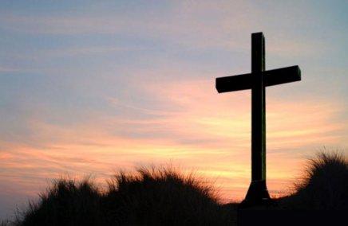
Being a scientist and a Christian
+
Notes:
Over the years people have asked me how I can be a scientist and a Christian, mainly in the context of evolution. So this morning I am going to address how I can justify to myself and others working in a field that is staunchly antireligion.

Slide 2
Science isn’t inherently evil
Some professions are inherently evil
Abortion doctors, prostitutes, drug dealers
Each job comes with inherent risks to sin
Bankers, politicians, doctors, lawyers
Christians are commanded to work
Ephesians 4:28, 1 Thess. 4:11, 2 Thess. 3:12
Notes:
I’d like to start with the fact that science isn’t inherently evil. Why is this relevant? Did I just want to put a mad scientist on my slide? Well yes, but when you describe something as evil you’re saying it is sinful. And if science is sinful then there is no way I could justify my participation in it. For example, being an abortion doctor or a prostitute is evil in and of itself.
Evil, as I’ve defined in previous sermons, is something that is profoundly immoral and malevolent. In a strictly Christian context evil is sin.
In the examples I have up there, the task you have to perform to be efficient in your profession is a sin. Abortion = murder, prostitutes = sexual immorality, drug dealers = lots of things.
A banker is surrounded by money and succeptible to greed and covetousness, a politician is susceptible to corruption, a doctor is susceptible to neglecting family, a lawyer is susceptible to circumventing the law. But none of these jobs are sinful.
As christians we are all commanded to work. I have to have a job, and this is the job I choose to have and as a Christian it is a job I’m allowed to have.

Slide 3
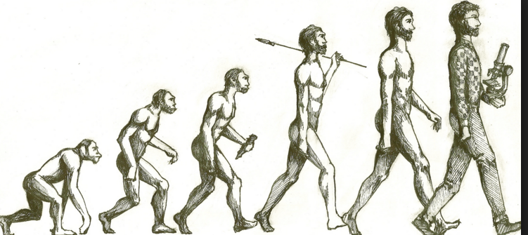
What about evolution?
Science ≠ evolution
Be Understanding
Recognize there are some answers neither side has
Notes:
Let’s get the big one out of the way first. A lot of people hear “science” and immediately go to “evolution” The first thing to keep in mind is science doesn’t equal evolution.
Science – systematic study of the natural world through observation and experiment
Evolution – process by which different living organisms have thought to developed
My job doesn’t involve me trying to prove evolution. At all.
However it won’t surprise any of you here that evolution is the predominant explanation for the beginning of our universe and many scientists hold that view as well as the view that there is no God.
SO how does one deal with people like that on a daily basis? Basically you have to be understanding. Recognize we don’t have all the answers. And recognize their reliance on evolution to fill a void in their belief system. If you don’t want to believe in God you have to have something that takes the place of him creating the universe. Because believing God created the universe but not believing you are subject to him makes no logical sense.
Also, recognize we don’t have all the answers. How is it that there has always been something? Both sides claim that, we say God they say matter. Either way, something has always existed and will always exist. How is that possible? It makes no sense.
How did DNA get made without the proteins that are used to make DNA, and how did those proteins get made to make DNA before there was DNA to make the proteins to make itself? The Bible isn’t a book of Science. It just isn’t. We can’t rely on it to answer every question we have about every minutiae of our world. It fills us in on what’s important and God has given us the ability to figure the rest of it out.

Slide 4
Take a philosophy class
Evolutionary theory and morality don’t equal up
Proverbs 26:5
Notes:
This seems like it came out of left field but I’m in a philosophy class this semester and it’s been very eye opening. There is a strong disconnect between evolutionary theory and the moral/ethical theories scientist (and non-scientist) hold to.
In fact as we’ve talked about in a previous lesson, morality can’t really exist because that means everywhere has to be adhering to the same moral law, and that law had to come from somewhere.
So, take a philosophy class and stick strictly to the laws that govern evolutionary theory and use that as your moral compass. You’ll be considered evil and cruel and no one will agree with you. There’s a disconnect in what they “know” and what they “think.” Their own logic betrays them. Hold them to their own ideas and don’t let them pick and choose Christian morals when it is convenient to do so.
Proverbs 26:5 tells us a little bit about arguing with folks.

Slide 5
Don’t take hard stands on non-issues
Global warming, gun control, healthcare, tax code, environmentalism
Do any of these deal with someone’s salvation?
2 Timothy 2:23-24
Titus 3:1-2
Your influence can win people don’t destroy it
1 Peter 2:12
Notes:
Since most scientists I encounter are worldly, their concerns are inherently worldly. And as a Christian I can’t get caught up in that, and more importantly I can’t let them use my opinions on things to shape their view of Christianity.
Most scientists take an extremely hard stance on these and various other issues but as a Christian I have to keep in mind that being for either side of these issues isn’t going to influence someone’s salvation. And if it isn’t influencing their salvation I don’t want to argue with them about it lessening my influence with them.
Does me driving an electric car make me more or less of a christian than if I dive a combustion engine? If I’m not allowed to own a firearm can I still be a Christian? And so on. These are all contentious issues and there’s nothing wrong with taking a stand on any of them, but we have to remember more is at stake, and we can’t destroy our influence with someone because we think a pipeline should be built from Canada to the gulf of Mexico.

Slide 6
Stay Patient
Wait for the proper moments
How do you start a conversation with someone who hates the idea of religion?
Wait for them to bring it up.
2 Timothy 2:24-25
Outbursts do nothing
Proverbs 29:11
James 1:19-20
Notes:
When you work with the same people for years you get to learn the best way to approach them about any sort of topic. From needing a dogsitter to needing money to addressing supernatural topics like God.
People can rail against religion and be unabashedly sinful but in their weak moments when the deep thinking occurs they know there is something more. I have one friend who in no way could be described as religious.

Slide 7
Stay humble
Self promotion is a desired quality
Easy to be overtaken by conceit
Ridicule advances no one’s cause
Ephesians 4:29
James 3:9-10
Philippians 2:4-7
It dictates how we treat others
Colossians 3:12-14
Humility is a trait of God’s chosen ones
Notes:
Finally the best way to be a scientist and a christian is to stay humble.
The field I work in encourages self-promotion. Money doesn’t freely flow and so one has to set themselves apart from everyone else for a piece of the limited resource pie. What’s worse, is once someone gets a piece of that pie they get propelled into the limelight pretty quickly.
It’s a different world in that strength isn’t the measure of worth. It’s knowledge. And the ability to show how much smarter you are than someone else gives you the chance to make a competitor look bad while shamelessly promoting yourself.
To combat conceit one has to remain humble. It’s hard, I doubt any of us do a good enough job with humility. I know I don’t. Humility is the quintessential trait of being a Christian. Nothing more perfectly describes the way a Christian should act.
In a world full of arrogance and pride and self serving goals, humility goes a long way.
On top of not being conceited ridicule has no place in the verbal arsenal of a Christian. Ephesians 4:29 tells us to speak things for building up, no corrupt thing is to come out of our mouths. Mocking speech and jokes about people who believe differently than us isn’t Christ-like. James 3 tells us we shouldn’t curse men with our mouths while the same mouth blesses God. Every scientist is made in the image of God just like us, and with that comes a degree of respect we owe them and everyone.
Of course being humble is the solution to any of these predicaments.
Look to the interests of others and count them as more significant than yourself. That man over there mocking God and Christianity and shamelessly promoting himself is better than I am. That’s hard. But that’s what we have to do.
Finally as Christians, we are commanded to be humble.

