Slide 1
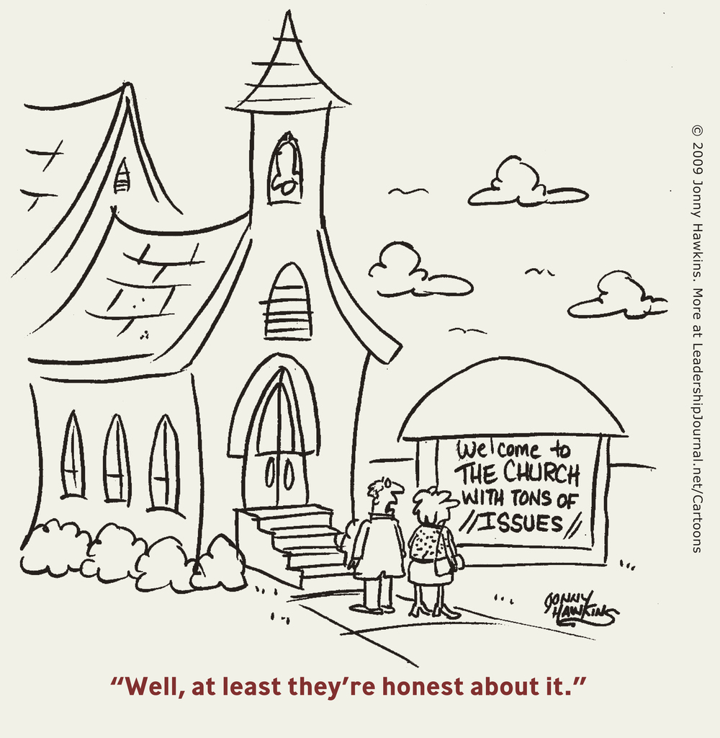
“A Glorious Church, Holy and without Blemish”
Eph. 5:27

Slide 2
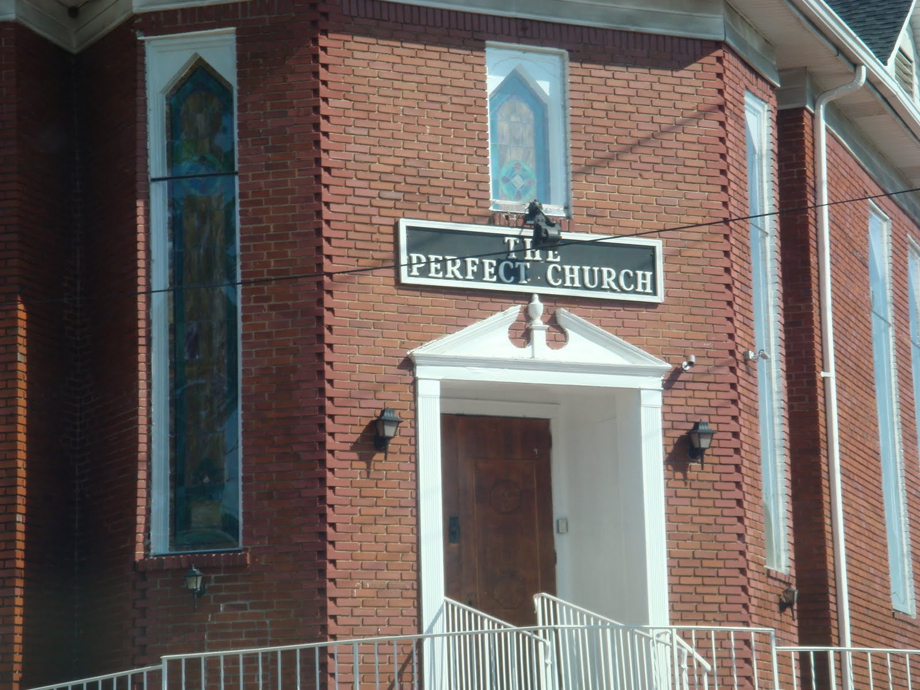

Slide 3
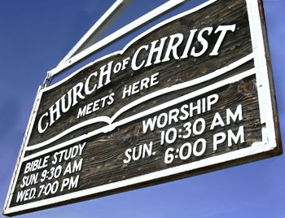
Move to new area & find a church:
Wonderful new building
Eloquent preacher
Great Bible classes
Friendly members
Kids same age as yours
5 min. from your home
Next door to your favorite restaurant

Slide 4
BUT…
Divisions
No growth
Arrogance
Sexual immorality
Members sue each other
Members tempt each other
Jealousy
Lack of brotherly love
“Crazy” services

Slide 5
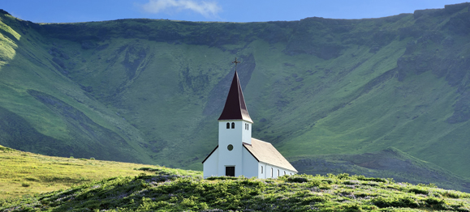
Would you want to join this church?
Could you help them resolve these problems?
Or would you look for another church with fewer problems?
What would you think of this church?

Slide 6
A Real Church
Divisions 1 Cor. 1:10-13
No growth 1 Cor. 3:1-3
Arrogance 1 Cor. 4:18-21
Sexual immorality 1 Cor. 5:1-2
Members sue each other 1 Cor. 6:1-7
Members tempt each other 1 Cor. 8:9-11
Mockery of Lord’s Supper 1 Cor. 11:20-22
Jealousy 1 Cor. 12:27-30
Lack of brotherly love 1 Cor. 13, 14:1
Crazy services 1 Cor. 11:4-5; 14:26-31
No belief in resurrection 1 Cor. 15:23

Slide 7
Yet even with all these problems…
Paul gave thanks for them 1 Cor. 1:4
They were “sanctified in Christ” 1 Cor. 1:2
Called to be saints 1 Cor. 1:2
Not lacking any spiritual gift 1 Cor. 1:7
Wise/sensible people 1 Cor. 10:15
Commended 1 Cor. 11:2
Have salvation 1 Cor. 15:2

Slide 8
Corinthian church improved
They repented! 2 Cor. 7:9-11
A living epistle 2 Cor. 3:2-3
Yet still work to do 2 Cor. 12:20-21
Work toward completeness, unity, and peace 2 Cor. 13:11

Slide 9
Application for Us Today
Would you have joined the church at Corinth?
What would Paul say to the churches in this area?
Understanding no church is perfect, what is our attitude toward others? Eph. 4:1-3
Are we doing our part to present the church without blemish to Christ? Eph. 5:27

