Slide 1
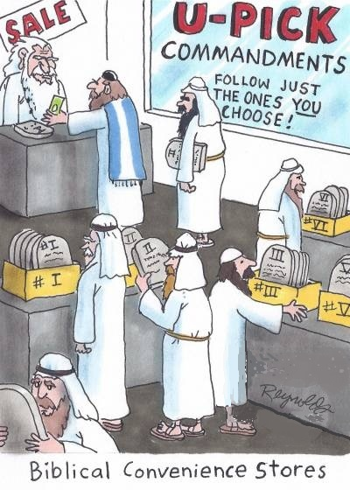
Lessons from Saul and Amalek 1 Sam. 15

Slide 2
History of the Amalekites
Likely descendants of Esau – Gen. 36:12
But see, Gen. 14:7
Cowardly attacked Israel – Deut. 25:17-19
“Did not fear God”
Israel’s first battle – Ex. 17:8-16
Nomads who continued to harass Israel – Jdg. 3:12-13; 6:3-5

Slide 3
God’s Judgment of Amalekites
Original command to blot them out – Deut. 25:19
Direct command given to King Saul to “utterly destroy” them – 1 Sam. 15:2-3
Saul attacked them (from Havilah all the way to Shur) – 1 Sam. 15:7

Slide 4
Breadth of Saul’s Attack

Slide 5
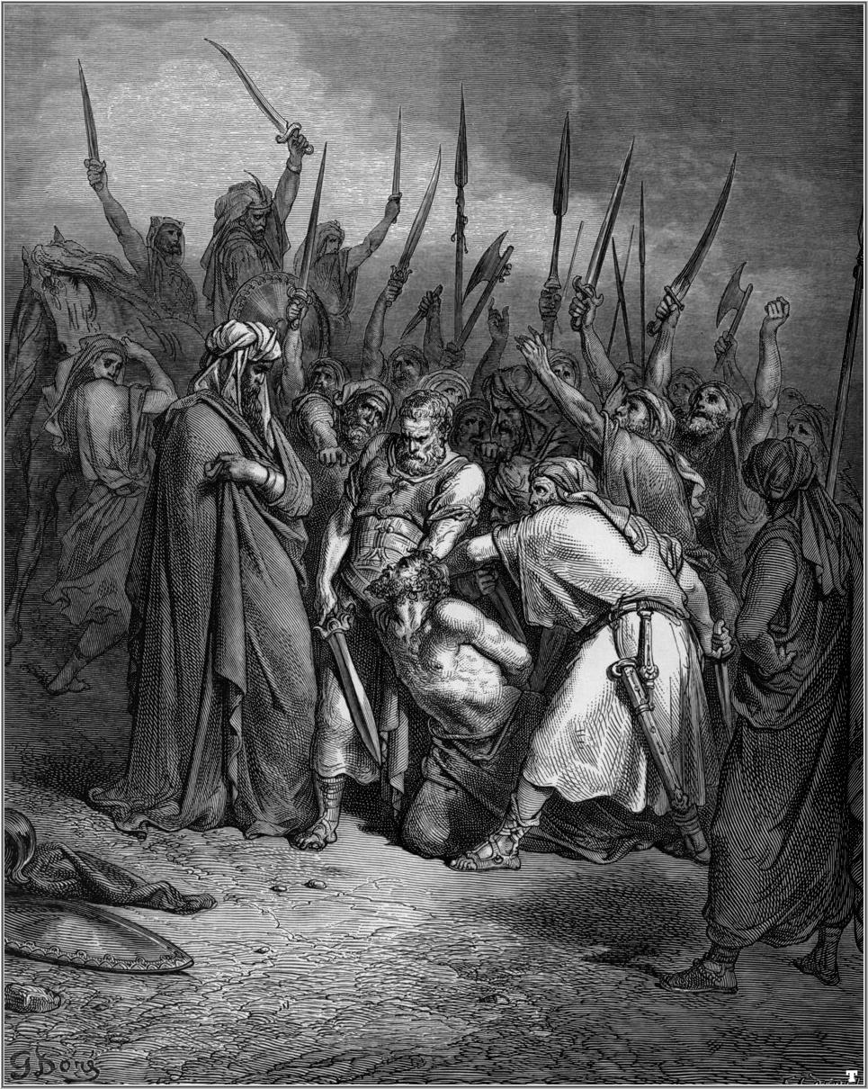
Saul’s Disobedience (1 Sam. 15)
Took King Agag captive – v. 8
Spared the best of Amalek’s flocks– v. 9
Blamed others – v. 21
Others apparently escaped – 1 Sam. 30:1-5

Slide 6
Saul’s Misunderstanding
“I have performed the commandment of the Lord.” – v. 13
Animals to sacrifice “which should have been utterly destroyed” (v. 21), “and the rest we have utterly destroyed.” – v. 15
“But I have obeyed the voice of the Lord… and brought back Agag king of Amalek; I have utterly destroyed the Amalekites.” – v. 20

Slide 7
Consequences of Saul’s Actions
Disappointment to others – 1 Sam. 15:11, 35
Cost him his kingdom – 1 Sam. 15:23-26
Later put out of misery by Amalekite – 2 Sam. 1:8-10
Agag not spared – 1 Sam. 15:32-33
Others had to finish the job – 1 Sam. 30:1-5, 17-19; 1 Chron. 4:43
Haman’s plot against Jews – Est. 3:1, 6

Slide 8
Lessons for Us
We must utterly destroy sin in our lives – Col. 3:2-10
We can’t pass the buck to others – 2 Cor. 5:10
God wants full obedience – 1 Sam. 15:22
Not our place to question why…
Must worship how God has authorized – Jn. 4:24
Can’t neglect any duties – Mt. 25:14-30

