Slide 1
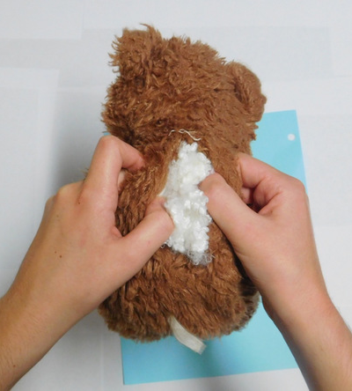

Slide 2
21st Century Christianity
Finding Church Unity

Slide 3
A Desire For Unity
Proverbs 6:16-19; Psalm 133:1
God has always had a desire for unity
John 17:20-23
Jesus prayed for Christian unity
1st Corinthians 1:10-11; Ephesians 4:1-5
Paul demanded unity
Unity won’t be achieved unless it is pursued

Slide 4
What Brings Unity
We can experience moments of unity
Acts 2:44
Biblical unity can seem like a far fetched dream
We share fellowship because of our relationship with Jesus
Why do many churches never find unity?

Slide 5
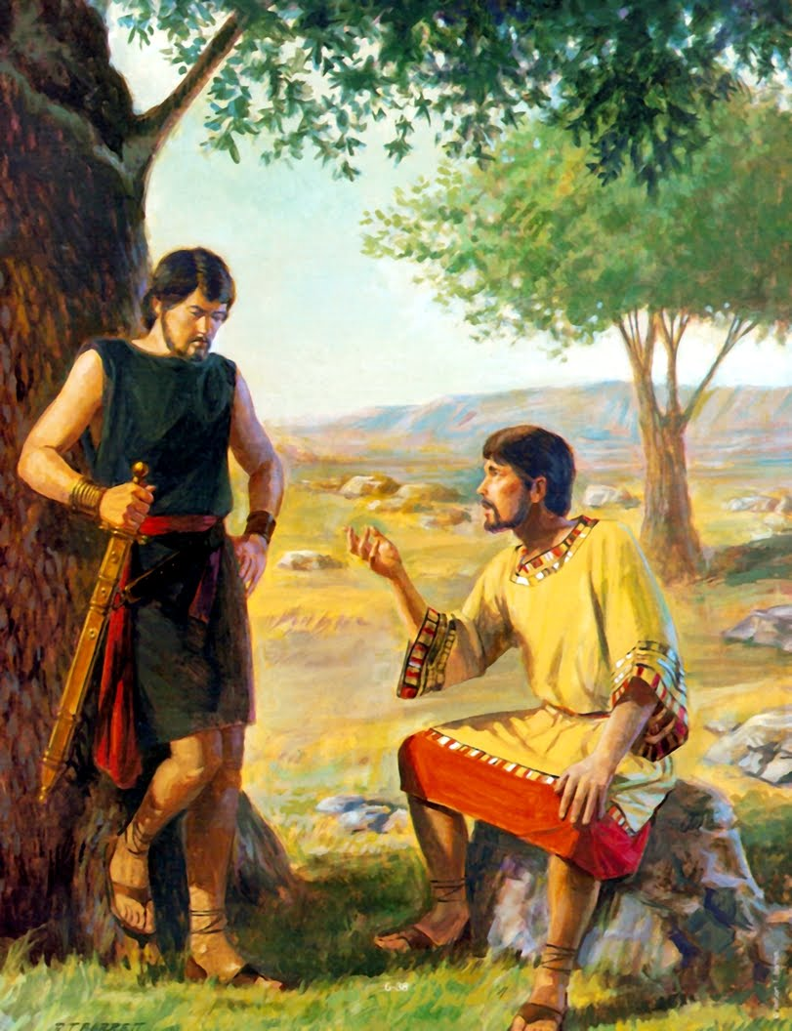
The Tie That Binds
1st Samuel 18:1-5; 19:1, 6
David and Johnathan were tied together because of love
Saul’s relationship with David was one of convenience
The love between Johnathan and David stood between his problems with Saul

Slide 6
The Tie That Binds
Colossians 2:1-3
Love is the tie that will knit our souls together in Christ
Aren’t there a lot of things that go into Christian unity?
Colossians 3:12-14
Love is the most important aspect of our relationship
1st Corinthians 13:1-3
Without love, everything else ends up causing problems

Slide 7
Testing Our Unity
Satan will not allow unity to go unhindered
What things threaten church unity?
Hurt feelings
Mutual understanding of biblical concepts
Disagreement of areas of judgment
Immaturity
1st Peter 4:8

