Slide 1
21st Century Christianity
How to Change the Church

Slide 2
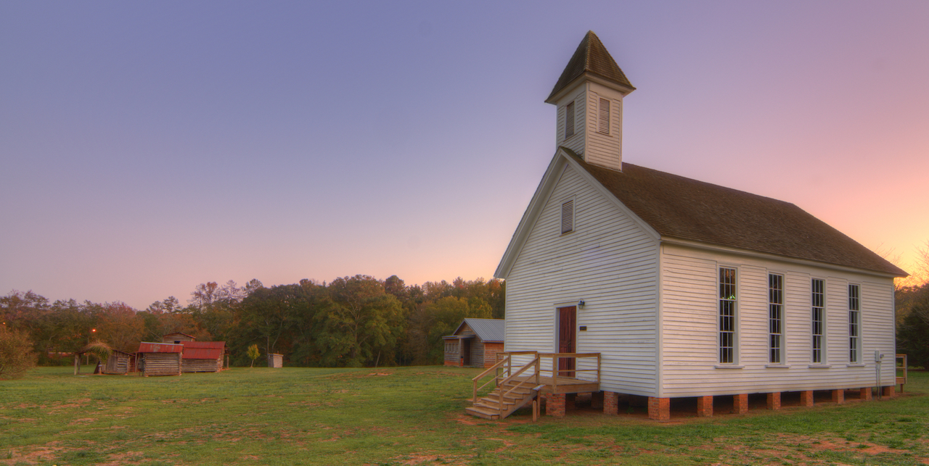
Is Your Church Where It Needs to Be?
Philippians 3:12-15
Have you arrived?
The church is made up of people so…
Most churches have work to do
Lack of growth isn’t a problem, it’s an opportunity

Slide 3
Have You Identified Legitimate Problems
There are several things people look for in a congregation:
Exciting worship services
Peer/Age Groups
Non-Judgmental preaching
Nice facilities or amenities
Lots of activities or ministries
Do these mirror what God’s plan is for a local church? If not, we will be disappointed

Slide 4
The Purpose of the Church
Ephesians 4:11-16
God structured the roles in the church to meet His overall goal – spiritual maturity
Acts 20:17-21; Hebrews 3:13
Paul’s relationship to those in the church centered around spiritual edification
If we shift the purpose to physical fulfillment, then we lose our focus, or people are unhappy

Slide 5
A Part of the Body
1st Corinthians 12:14-18
Each of us needs to be active in the spiritual growth of the body
These functions are ones of service, not of being served
Philippians 2:19-24
Even among Christians, people that truly embrace their role are few and far between
Our role is not to be the one gauging the effectiveness of everyone else’s serving

Slide 6
Serving People
1st Thessalonians 2:17-20; Philippians 4:1
When we invest in something, we find happiness from that experience
You will love those who you help grow into stronger Christians
You can take pleasure in the success of families you have helped
Why are you here?

Slide 7
You Can Change the Church
Leaders lead by example
Strong churches are built on strong relationships
Avoid the destructive change-agents of gossip, backbiting, anger, frustration, and discouragement
Traditions aren’t the same as truth – change what needs to be changed
Leaving is a last resort

