Slide 1
What is man that you are mindful of him?

Slide 2
What is man that you are mindful of him?
Hebrews 2:6-8
1. Paul quotes language of David (Psalm 8:3-6)
2. Each shows the insignificance of man

Slide 3
What is man that you are mindful of him?
Hebrews 2:6-8
But one testified in a certain place, saying: "What is man that You are mindful of him, Or the son of man that You take care of him? You have made him a little lower than the angels; You have crowned him with glory and honor, And set him over the works of Your hands. You have put all things in subjection under his feet." For in that He put all in subjection under him, He left nothing that is not put under him. But now we do not yet see all things put under him.

Slide 4
What is man that you are mindful of him?
Psalm 8:3-6
When I consider Your heavens, the work of Your fingers, The moon and the stars, which You have ordained, What is man that You are mindful of him, And the son of man that You visit him? For You have made him a little lower than the angels, And You have crowned him with glory and honor. You have made him to have dominion over the works of Your hands; You have put all things under his feet,

Slide 5
What is man that you are mindful of him?
I. What May Be Learned From The Text?
1. God is mindful of all that He has created
a. Man (Matthew 5:44-45)
b. Animals (Psalm 104:24-30)
c. Birds (Matthew 10:29, Luke 12:24)

Slide 6
What is man that you are mindful of him?
I. What May Be Learned From The Text?
1. God is mindful of all that He has created
a. Man (Matthew 5:44-45)
But I say to you, love your enemies, bless those who curse you, do good to those who hate you, and pray for those who spitefully use you and persecute you, that you may be sons of your Father in heaven; for He makes His sun rise on the evil and on the good, and sends rain on the just and on the unjust.

Slide 7
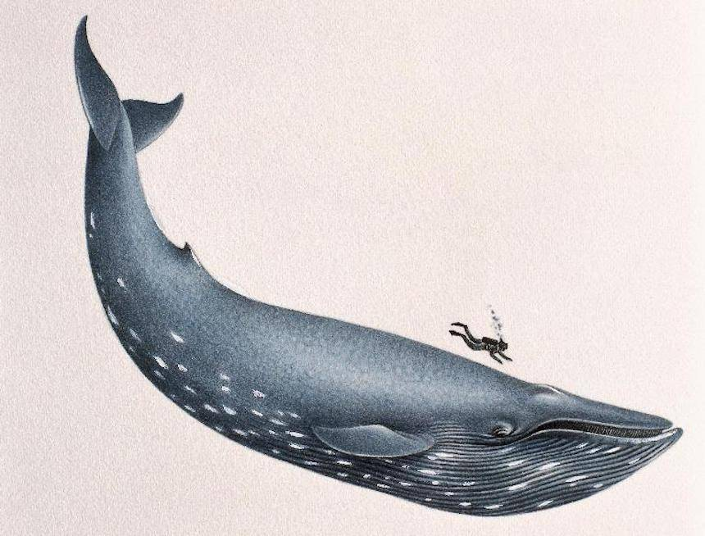
What is man that you are mindful of him?
I. What May Be Learned From The Text?
1. God is mindful of all that He has created
b. Animals (Psalm 104:24-30)
O LORD, how manifold are Your works! In wisdom You have made them all. The earth is full of Your possessions--This great and wide sea, In which are innumerable teeming things, Living things both small and great. There the ships sail about; There is that Leviathan Which You have made to play there. These all wait for You, That You may give them their food in due season. What You give them they gather in; You open Your hand, they are filled with good. You hide Your face, they are troubled; You take away their breath, they die and return to their dust. You send forth Your Spirit, they are created; And You renew the face of the earth.

Slide 8
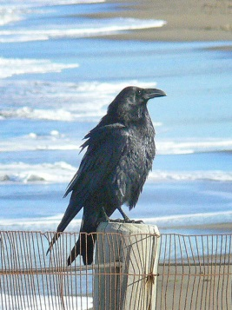
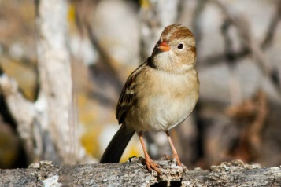
What is man that you are mindful of him?
I. What May Be Learned From The Text?
1. God is mindful of all that He has created
c. Birds (Matthew 10:29, Luke 12:24)
Are not two sparrows sold for a copper coin? And not one of them falls to the ground apart from your Father's will.
Consider the ravens, for they neither sow nor reap, which have neither storehouse nor barn; and God feeds them. Of how much more value are you than the birds?

Slide 9
What is man that you are mindful of him?
II. Why Is God So Mindful Of Man?
1. Man is His offspring (Luke 3:38, Acts 17:29)
2. Man is dependent on Him (Acts 17:25)
3. Man was made in His image (Genesis 1:26)
4. He loves man (John 3:16, Romans 5:6-8)
5. He desires the love of man (John 14:23)

Slide 10
What is man that you are mindful of him?
II. Why Is God So Mindful Of Man?
1. Man is His offspring (Luke 3:38, Acts 17:29)
the son of Enos, the son of Seth, the son of Adam, the son of God.
Therefore, since we are the offspring of God, we ought not to think that the Divine Nature is like gold or silver or stone, something shaped by art and man's devising.

Slide 11
What is man that you are mindful of him?
II. Why Is God So Mindful Of Man?
2. Man is dependent on Him (Acts 17:25)
Nor is He worshiped with men's hands, as though He needed anything, since He gives to all life, breath, and all things.

Slide 12
What is man that you are mindful of him?
II. Why Is God So Mindful Of Man?
3. Man was made in His image (Genesis 1:26)
Then God said, "Let Us make man in Our image, according to Our likeness; let them have dominion over the fish of the sea, over the birds of the air, and over the cattle, over all the earth and over every creeping thing that creeps on the earth."

Slide 13
What is man that you are mindful of him?
II. Why Is God So Mindful Of Man?
4. He loves man (John 3:16, Romans 5:6-8)
For God so loved the world that He gave His only begotten Son, that whoever believes in Him should not perish but have everlasting life.
For when we were still without strength, in due time Christ died for the ungodly. For scarcely for a righteous man will one die; yet perhaps for a good man someone would even dare to die. But God demonstrates His own love toward us, in that while we were still sinners, Christ died for us.

Slide 14
What is man that you are mindful of him?
II. Why Is God So Mindful Of Man?
5. He desires the love of man (John 14:23)
Jesus answered and said to him, "If anyone loves Me, he will keep My word; and My Father will love him, and We will come to him and make Our home with him.

Slide 15
What is man that you are mindful of him?
III. Of What is God Mindful?
1. Our needs (Luke 12:30)
2. Our lost condition (Luke 19:10)
3. Our weakness (Hebrews 4:15-16)
4. Our sorrows (Isaiah 53:4)
5. Our “labor of love” (Hebrews 6:10)
6. Our temptations (Heb. 2:18, 1 Corinthians 10:13)
7. His own promises (Psalm 111:5, 2 Peter 3:9)

Slide 16
What is man that you are mindful of him?
III. Of What is God Mindful?
1. Our needs (Luke 12:30)
For all these things the nations of the world seek after, and your Father knows that you need these things.

Slide 17
What is man that you are mindful of him?
III. Of What is God Mindful?
2. Our lost condition (Luke 19:10)
for the Son of Man has come to seek and to save that which was lost."

Slide 18
What is man that you are mindful of him?
III. Of What is God Mindful?
3. Our weakness (Hebrews 4:15-16)
For we do not have a High Priest who cannot sympathize with our weaknesses, but was in all points tempted as we are, yet without sin. Let us therefore come boldly to the throne of grace, that we may obtain mercy and find grace to help in time of need.

Slide 19
What is man that you are mindful of him?
III. Of What is God Mindful?
4. Our sorrows (Isaiah 53:4)
Surely He has borne our griefs And carried our sorrows; Yet we esteemed Him stricken, Smitten by God, and afflicted.

Slide 20
What is man that you are mindful of him?
III. Of What is God Mindful?
5. Our “labor of love” (Hebrews 6:10)
For God is not unjust to forget your work and labor of love which you have shown toward His name, in that you have ministered to the saints, and do minister.

Slide 21
What is man that you are mindful of him?
III. Of What is God Mindful?
6. Our temptations (Heb. 2:18, 1 Corinthians 10:13)
For in that He Himself has suffered, being tempted, He is able to aid those who are tempted.
No temptation has overtaken you except such as is common to man; but God is faithful, who will not allow you to be tempted beyond what you are able, but with the temptation will also make the way of escape, that you may be able to bear it.

Slide 22
What is man that you are mindful of him?
III. Of What is God Mindful?
7. His own promises (Psalm 111:5, 2 Peter 3:9)
He has given food to those who fear Him; He will ever be mindful of His covenant.
The Lord is not slack concerning His promise, as some count slackness, but is longsuffering toward us, not willing that any should perish but that all should come to repentance.

Slide 23
What is man that you are mindful of him?
IV. Of Whom Has He Been Mindful?
1. The Jews (Psalm 115:12)
2. The righteous (1 Peter 3:12)
3. All who seek Him (Matt 6:25-34, 28:18-20)

Slide 24
What is man that you are mindful of him?
IV. Of Whom Has He Been Mindful?
1. The Jews (Psalm 115:12)
The LORD has been mindful of us; He will bless us; He will bless the house of Israel; He will bless the house of Aaron.

Slide 25
What is man that you are mindful of him?
IV. Of Whom Has He Been Mindful?
2. The righteous (1 Peter 3:12)
For the eyes of the LORD are on the righteous, And His ears are open to their prayers; But the face of the LORD is against those who do evil."

Slide 26
What is man that you are mindful of him?
IV. Of Whom Has He Been Mindful?
3. All who seek Him (Matthew 6:25-34, 28:18-20)

Slide 27
What is man that you are mindful of him?
IV. Of Whom Has He Been Mindful?
3. All who seek Him (Matthew 6:25-34)
Therefore I say to you, do not worry about your life, what you will eat or what you will drink; nor about your body, what you will put on. Is not life more than food and the body more than clothing? Look at the birds of the air, for they neither sow nor reap nor gather into barns; yet your heavenly Father feeds them. Are you not of more value than they? Which of you by worrying can add one cubit to his stature? So why do you worry about clothing? Consider the lilies of the field, how they grow: they neither toil nor spin; and yet I say to you that even Solomon in all his glory was not arrayed like one of these. Now if God so clothes the grass of the field, which today is, and tomorrow is thrown into the oven, will He not much more clothe you, O you of little faith? Therefore do not worry, saying, 'What shall we eat?' or 'What shall we drink?' or 'What shall we wear?' For after all these things the Gentiles seek. For your heavenly Father knows that you need all these things. But seek first the kingdom of God and His righteousness, and all these things shall be added to you. Therefore do not worry about tomorrow, for tomorrow will worry about its own things. Sufficient for the day is its own trouble.

Slide 28
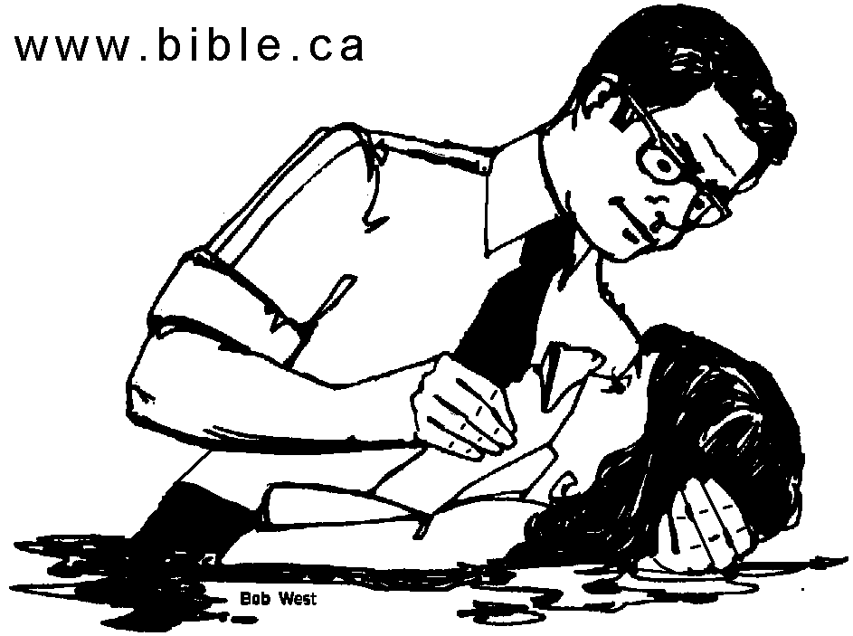
What is man that you are mindful of him?
IV. Of Whom Has He Been Mindful?
3. All who seek Him (Matthew 28:18-20)
And Jesus came and spoke to them, saying, "All authority has been given to Me in heaven and on earth. Go therefore and make disciples of all the nations, baptizing them in the name of the Father and of the Son and of the Holy Spirit, teaching them to observe all things that I have commanded you; and lo, I am with you always, even to the end of the age." Amen.

Slide 29
What is man that you are mindful of him?
Hebrews 2:6-8
I. What May Be Learned From The Text?
II. Why Is God So Mindful Of Man?
III. Of What is God Mindful?
IV. Of Whom Has He Been Mindful?
WHAT IS YOUR RESPONSE?

