Slide 1
Every Christian’s Guide To Effective Evangelism
1 Peter 3:15
By David Dann

Slide 2
Every Christian’s Guide To Effective Evangelism

Slide 3
www.uccathens.com

Slide 4
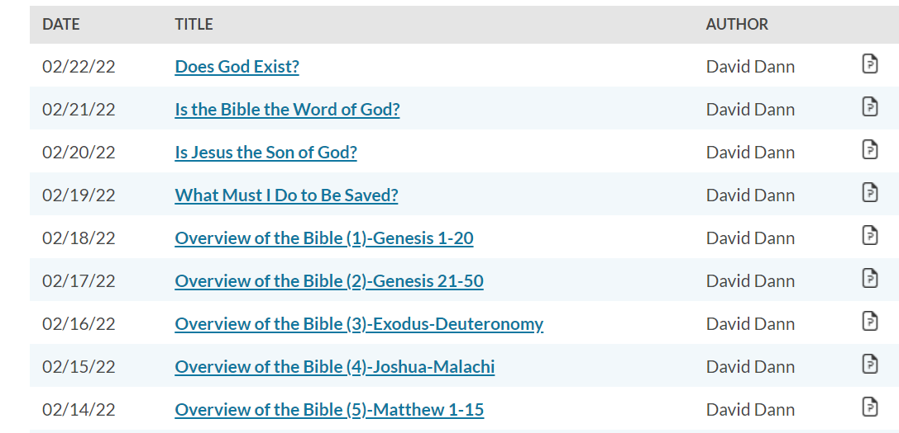
Presentations
www.uccathens.com

Slide 5
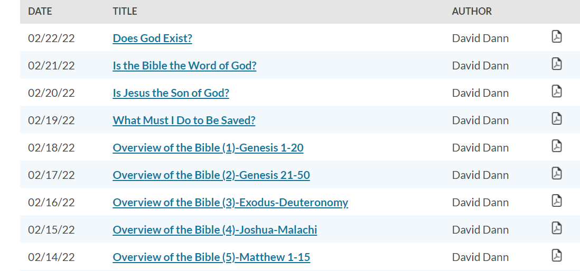
Outlines
www.uccathens.com

Slide 6
Every Christian’s Guide To Effective Evangelism

Slide 7
Every Christian’s Guide To Effective Evangelism
The gospel message is the power God uses to save man.

Slide 8
Every Christian’s Guide To Effective Evangelism
Romans 1:16
16 For I am not ashamed of the gospel of Christ, for it is the power of God to salvation for everyone who believes, for the Jew first and also for the Greek.

Slide 9
Every Christian’s Guide To Effective Evangelism
John 3:16
16 For God so loved the world that He gave His only begotten Son, that whoever believes in Him should not perish but have everlasting life.

Slide 10
Every Christian’s Guide To Effective Evangelism
The gospel message is the power God uses to save man.

Slide 11
Every Christian’s Guide To Effective Evangelism
The gospel message is the power God uses to save man.
God’s power is unleashed when the gospel message is spread.

Slide 12
Every Christian’s Guide To Effective Evangelism
Romans 10:13-17
13 For "whoever calls on the name of the LORD shall be saved."
14 How then shall they call on Him in whom they have not believed? And how shall they believe in Him of whom they have not heard? And how shall they hear without a preacher?
15 And how shall they preach unless they are sent? As it is written: "How beautiful are the feet of those who preach the gospel of peace, Who bring glad tidings of good things!"
16 But they have not all obeyed the gospel. For Isaiah says, "Lord, who has believed our report?"
17 So then faith comes by hearing, and hearing by the word of God.

Slide 13
Every Christian’s Guide To Effective Evangelism
Mark 16:15-16
15 And He said to them, "Go into all the world and preach the gospel to every creature.
16 "He who believes and is baptized will be saved; but he who does not believe will be condemned."

Slide 14
Every Christian’s Guide To Effective Evangelism
2 Timothy 2:1-2
1 You therefore, my son, be strong in the grace that is in Christ Jesus.
2 And the things that you have heard from me among many witnesses, commit these to faithful men who will be able to teach others also.

Slide 15
Every Christian’s Guide To Effective Evangelism
The gospel message is the power God uses to save man.
God’s power is unleashed when the gospel message is spread.

Slide 16
Every Christian’s Guide To Effective Evangelism
The gospel message is the power God uses to save man.
God’s power is unleashed when the gospel message is spread.
How can we effectively spread the word?

Slide 17
Every Christian’s Guide To Effective Evangelism
1 Peter 3:14-16
14 But even if you should suffer for righteousness' sake, you are blessed. "And do not be afraid of their threats, nor be troubled."
15 But sanctify the Lord God in your hearts, and always be ready to give a defense to everyone who asks you a reason for the hope that is in you, with meekness and fear;
16 having a good conscience, that when they defame you as evildoers, those who revile your good conduct in Christ may be ashamed.

Slide 18
Every Christian’s Guide To Effective Evangelism

Slide 19
Every Christian’s Guide To Effective Evangelism
1
Sanctify The Lord In Your Heart

Slide 20
Every Christian’s Guide To Effective Evangelism
1 Peter 3:14-16
14 But even if you should suffer for righteousness' sake, you are blessed. "And do not be afraid of their threats, nor be troubled."
15 But sanctify the Lord God in your hearts, and always be ready to give a defense to everyone who asks you a reason for the hope that is in you, with meekness and fear;
16 having a good conscience, that when they defame you as evildoers, those who revile your good conduct in Christ may be ashamed.

Slide 21
Every Christian’s Guide To Effective Evangelism
1
Sanctify The Lord In Your Heart

Slide 22
Every Christian’s Guide To Effective Evangelism
1
Sanctify The Lord In Your Heart
What does this mean?

Slide 23
Every Christian’s Guide To Effective Evangelism
1
Sanctify The Lord In Your Heart
What does this mean?
Our focus needs to be on God.

Slide 24
Every Christian’s Guide To Effective Evangelism
1
Sanctify The Lord In Your Heart
What does this mean?
Our focus needs to be on God.
Our lives must be right with God.

Slide 25
Every Christian’s Guide To Effective Evangelism
1
Sanctify The Lord In Your Heart
What does this mean?
Our focus needs to be on God.
Our lives must be right with God.
We cannot fear men.

Slide 26
Every Christian’s Guide To Effective Evangelism

Slide 27
Every Christian’s Guide To Effective Evangelism
2
Always Be Ready To Give A Defense

Slide 28
Every Christian’s Guide To Effective Evangelism
1 Peter 3:14-16
14 But even if you should suffer for righteousness' sake, you are blessed. "And do not be afraid of their threats, nor be troubled."
15 But sanctify the Lord God in your hearts, and always be ready to give a defense to everyone who asks you a reason for the hope that is in you, with meekness and fear;
16 having a good conscience, that when they defame you as evildoers, those who revile your good conduct in Christ may be ashamed.

Slide 29
Every Christian’s Guide To Effective Evangelism
2
Always Be Ready To Give A Defense

Slide 30
Every Christian’s Guide To Effective Evangelism
2
Always Be Ready To Give A Defense
What do we need to defend?

Slide 31
Every Christian’s Guide To Effective Evangelism
2
Always Be Ready To Give A Defense
What do we need to defend?
Get yourself ready to defend the truth.

Slide 32
Every Christian’s Guide To Effective Evangelism
2
Always Be Ready To Give A Defense
What do we need to defend?
Get yourself ready to defend the truth.
Be ready all the time!

Slide 33
Every Christian’s Guide To Effective Evangelism

Slide 34
Every Christian’s Guide To Effective Evangelism
3
Teach Everyone You Can

Slide 35
Every Christian’s Guide To Effective Evangelism
1 Peter 3:14-16
14 But even if you should suffer for righteousness' sake, you are blessed. "And do not be afraid of their threats, nor be troubled."
15 But sanctify the Lord God in your hearts, and always be ready to give a defense to everyone who asks you a reason for the hope that is in you, with meekness and fear;
16 having a good conscience, that when they defame you as evildoers, those who revile your good conduct in Christ may be ashamed.

Slide 36
Every Christian’s Guide To Effective Evangelism
3
Teach Everyone You Can

Slide 37
Every Christian’s Guide To Effective Evangelism
3
Teach Everyone You Can
Everyone needs the gospel.

Slide 38
Every Christian’s Guide To Effective Evangelism
3
Teach Everyone You Can
Everyone needs the gospel.
Don’t be limited by prejudice!

Slide 39
Every Christian’s Guide To Effective Evangelism

Slide 40
Every Christian’s Guide To Effective Evangelism
4
Focus On The Message Of Hope

Slide 41
Every Christian’s Guide To Effective Evangelism
1 Peter 3:14-16
14 But even if you should suffer for righteousness' sake, you are blessed. "And do not be afraid of their threats, nor be troubled."
15 But sanctify the Lord God in your hearts, and always be ready to give a defense to everyone who asks you a reason for the hope that is in you, with meekness and fear;
16 having a good conscience, that when they defame you as evildoers, those who revile your good conduct in Christ may be ashamed.

Slide 42
Every Christian’s Guide To Effective Evangelism
4
Focus On The Message Of Hope

Slide 43
Every Christian’s Guide To Effective Evangelism
4
Focus On The Message Of Hope
Don’t focus on the wrong things.

Slide 44
Every Christian’s Guide To Effective Evangelism
4
Focus On The Message Of Hope
Don’t focus on the wrong things.
The gospel is man’s only hope!

Slide 45
Every Christian’s Guide To Effective Evangelism

Slide 46
Every Christian’s Guide To Effective Evangelism
5
Approach Others With Meekness & Fear

Slide 47
Every Christian’s Guide To Effective Evangelism
1 Peter 3:14-16
14 But even if you should suffer for righteousness' sake, you are blessed. "And do not be afraid of their threats, nor be troubled."
15 But sanctify the Lord God in your hearts, and always be ready to give a defense to everyone who asks you a reason for the hope that is in you, with meekness and fear;
16 having a good conscience, that when they defame you as evildoers, those who revile your good conduct in Christ may be ashamed.

Slide 48
Every Christian’s Guide To Effective Evangelism
5
Approach Others With Meekness & Fear

Slide 49
Every Christian’s Guide To Effective Evangelism
5
Approach Others With Meekness & Fear
We need to be careful about our approach.

Slide 50
Every Christian’s Guide To Effective Evangelism
5
Approach Others With Meekness & Fear
We need to be careful about our approach.
Approach others the way you want to be approached!

Slide 51
Every Christian’s Guide To Effective Evangelism
1
Sanctify The Lord In Your Heart
2
Always Be Ready To Give A Defense
3
Teach Everyone You Can
4
Focus On The Message Of Hope
5
Approach Others With Meekness & Fear

Slide 52
Let’s work for the Lord!!!

